Slide 1








Best Practices: Data and Metadata Submission
https://arcticdata.io
@arcticdatactr
Matthew B. Jones
jones@nceas.ucsb.edu
https://orcid.org/0000-0003-0077-4738
@metamattj
NSF Award #1546024
Notes:
Welcome, everyone. We’re really excited that you’ve joined us for today’s best practices for data and metadata workshop. Today, we’ll be focusing on how to approach management and sharing of Arctic data to make it FAIR: Findable, Accessible, Interoperable, and Re-usable.

Slide 2



Computational Reproducibility
Data
Preservation enables:
Understanding
Evaluation
Reuse
Future You!
Metadata
Software

Slide 3
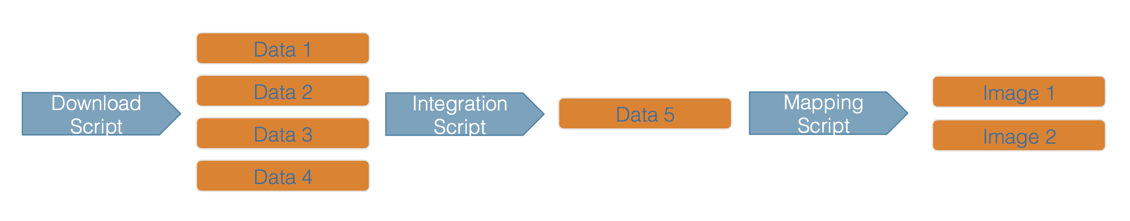

Computational Workflows
Rama

Slide 4
Data Packages
Raw data package
Derived data package
Rama

Slide 5
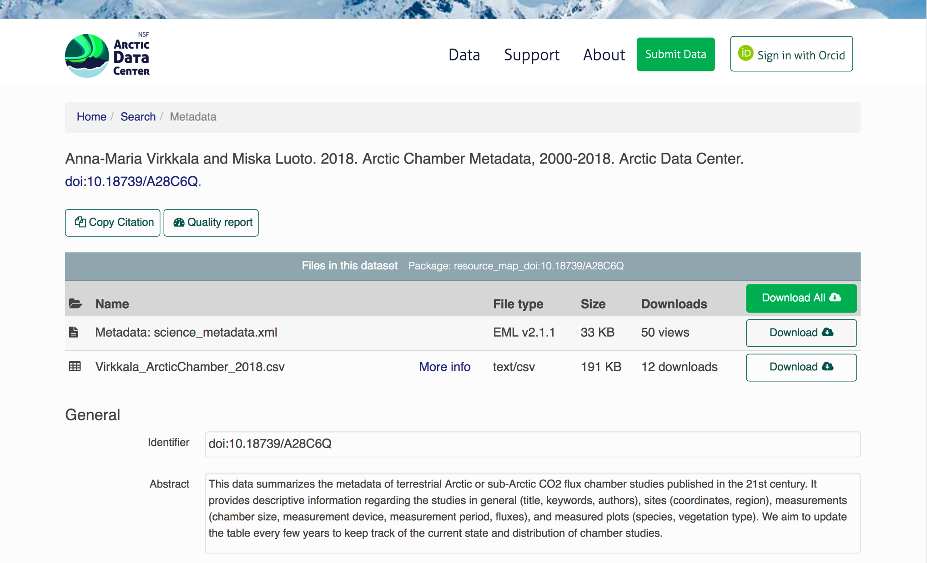

Slide 6



Practical Reproducibility
Preserve the data
Preserve the software workflow
Document what you did
Describe how to interpret it all
Notes:
Proceed through the 36 month project milestones in order.
Next, Matt Jones on provenance.

Slide 7
Data and Metadata
Guidelines

Slide 8
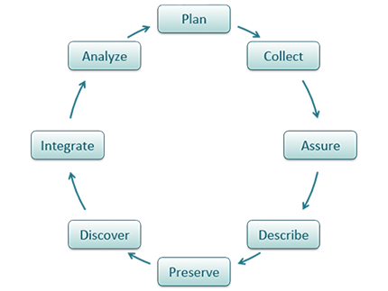
A Data Life Cycle
https://www.dataone.org/best-practices
Notes:
When you take a look at the Data Life Cycle, planning is at the top. Which makes sense as planning is usually the first action you take, albeit in different forms, when you start thinking about a new research project.

Slide 9
A Data Life Cycle
https://www.dataone.org/best-practices
Notes:
When you take a look at the Data Life Cycle, planning is at the top. Which makes sense as planning is usually the first action you take, albeit in different forms, when you start thinking about a new research project.

Slide 10
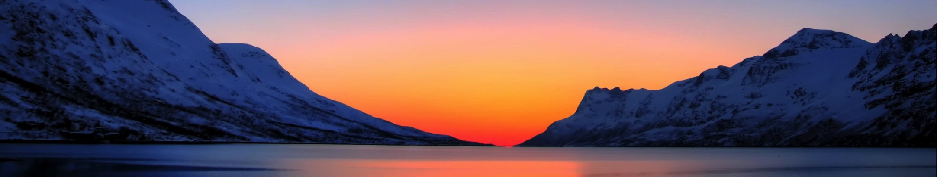
Guidelines
https://arcticdata.io/submit/
Organizing Data
File Formats
Large Data Packages
Metadata
Data Identifiers
Provenance
Troms Fylke

Slide 11
Organizing Data
Understand basics of “tidy” data models
Design and create effective data tables
Benefits of tidy data systems
Powerful search and filtering
Handle large, complex data sets
Enforce data integrity
Decrease errors from redundant updates
Data

Slide 12
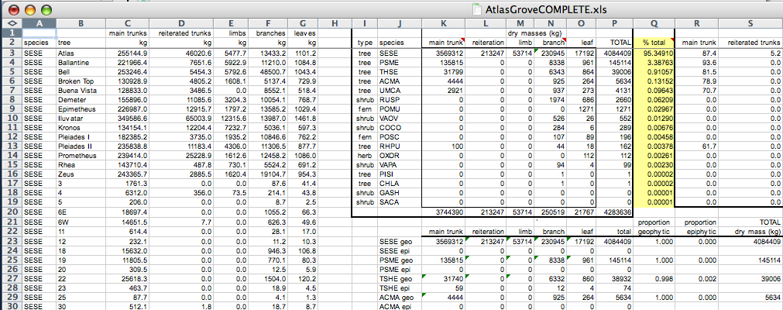
Not Tidy: Multiple Tables
Table 1
Table 2
Table 3

Slide 13
Not Tidy: Inconsistent observations
All the same observation?
No.

Slide 14
Not Tidy: Inconsistent variables
All the same variable?
No.

Slide 15
Not Tidy: Marginal info
Marginal
sums and
totals

Slide 16
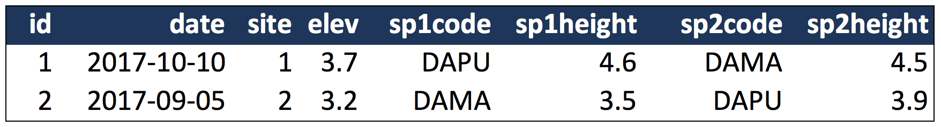
Data Modeling 101
Denormalized data (aka, not Tidy)
Observations about different entities combined

Slide 17
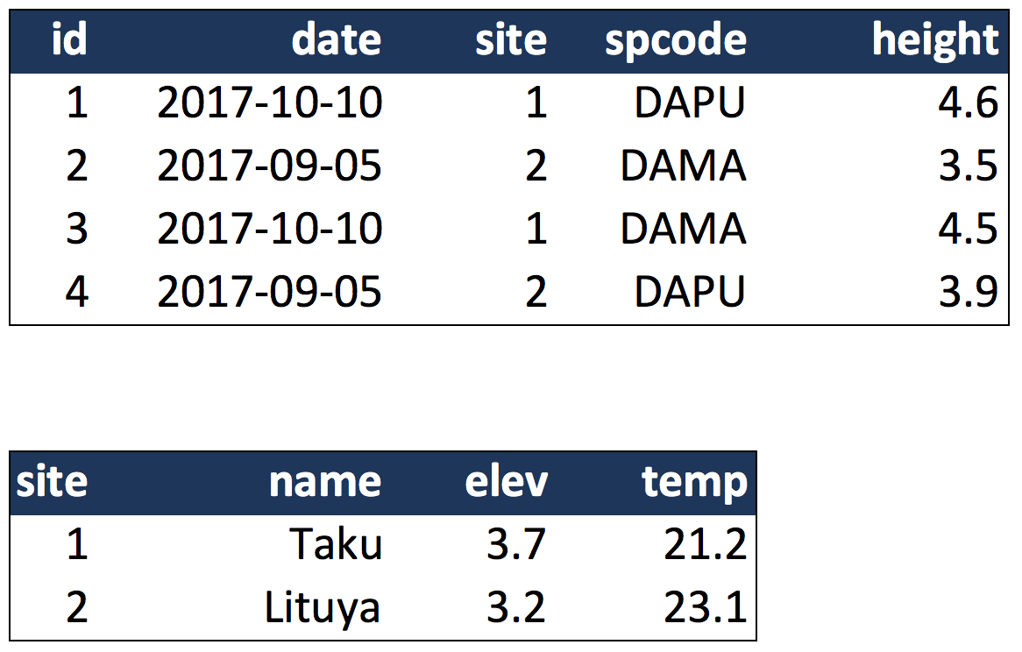
Tidy Data (observe one entity per table)
Species observations
Site observations

Slide 18
Tidy Data (Relational)
Join Key
Species observations
Site observations

Slide 19
Organizing Data: Best Practices
Some Simple Guidelines for Effective Data Management.
Borer et al. 2009. Bulletin of the Ecological Society of America. https://doi.org/10.1890/0012-9623-90.2.205
Nine simple ways to make it easier to (re)use your data.
White et al. 2013. Ideas in Ecology and Evolution 6. https://doi.org/10.4033/iee.2013.6b.6.f

Slide 20
Organizing Data: Best Practices
Scripts for all data manipulation
Uncorrected raw data file
Document processing in scripts
Design to add rows, not columns
Each column one variable
Each row one observation
Nonproprietary file formats
Descriptive names, no spaces
Header line

Slide 21
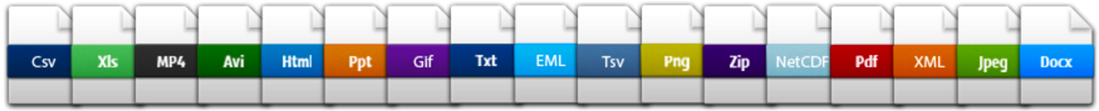
File Formats
https://arcticdata.io/submit/#file-format-guidelines
Open Formats
Text - support long term access and preservation
Open binary formats (NetCDF, HDF5)
Any (meta)data is better than none
Microsoft Excel: common but proprietary
Export GIS data to ESRI shapefiles
Export MATLAB, IDL, etc. to NetCDF
Always bet on text!

Slide 22
Large Data Packages (> Terabytes)
Talk to the data center early
Tile data structures by subset
Spatial regions
Temporal windows
Measured variables
Use efficient tools (NetCDF, HDF)
Compact data format
Parallel read/write libraries

Slide 23
Metadata
Guidelines

Slide 24
Metadata: the Goal
Target a typical researcher (maybe you!)
30+ years from now
Goal
Understand
Interpret
Re-use
Metadata
Notes:
Who knows, maybe you’re dataset is the next Keeling curve!

Slide 25
Metadata: the Goal
What was measured?
Who did it?
When and where?
How? (data structure & methods)
Why? (science context)
Attribution & Licensing
Metadata
Notes:
Who knows, maybe you’re dataset is the next Keeling curve!

Slide 26
Metadata: Bibliographic Details
Global Identifier (e.g., DOI)
Descriptive title
topic, geographic location, dates, and, if applicable, the scale of the data
Descriptive abstract
brief overview of the specific contents and purpose of the data package.
Funding information (award number and sponsor).
People and organizations
Creators – who should be cited for the data set
Contacts
Contributors
Sponsors, and more
Metadata
Notes:
Who knows, maybe you’re dataset is the next Keeling curve!

Slide 27
Metadata: Discovery Details
Geospatial coverage
Field and laboratory sampling locations
including place names and precise coordinates
Temporal Coverage
When measurements were made
To what time period do measurements apply
Might be calendar times, or geologic times
Taxonomic Coverage
What species were measured
Taxonomy standards and procedures
Other contextual information
Metadata
Notes:
Who knows, maybe you’re dataset is the next Keeling curve!

Slide 28
Metadata: Interpretation Details
Field and laboratory data collection methods
Full experimental and project design, and relationship to data
Full field and laboratory sample processing methods
Sampling quality control procedures
Analysis and modeling methods
Provenance information
Hardware and software used
including make, model, and version
Computing quality control procedures
testing, code review, etc.
Metadata
Notes:
Who knows, maybe you’re dataset is the next Keeling curve!

Slide 29
Metadata: Data Structure and Contents
Data model description
Data object descriptions (granules)
Tables
Images
Matrices
Spatial layers, etc.
Variable information (attributes/parameters)
Definitions / link to methods
Standardized measurement types
Units
Coded values
Missing value codes
Metadata
Notes:
Who knows, maybe you’re dataset is the next Keeling curve!

Slide 30
Metadata: Rights and Attribution
Scientific rights and expectations
Citation format
Attribution expectations
Reuse rights
Who may reuse data, and for what purposes
Redistribution rights
Who may copy and redistribute data and metadata
Legal terms and conditions
Licensing terms
Metadata
Notes:
Who knows, maybe you’re dataset is the next Keeling curve!

Slide 31
Metadata Standards
Ecological Metadata Language (EML)
Geospatial Metadata Standards
(ISO 19115*, ISO 19139)
Biological Data Profile (BDP)
Dublin Core
Darwin Core
PREMIS and METS
… and the list goes on
Metadata
Notes:
Who knows, maybe you’re dataset is the next Keeling curve!

Slide 32
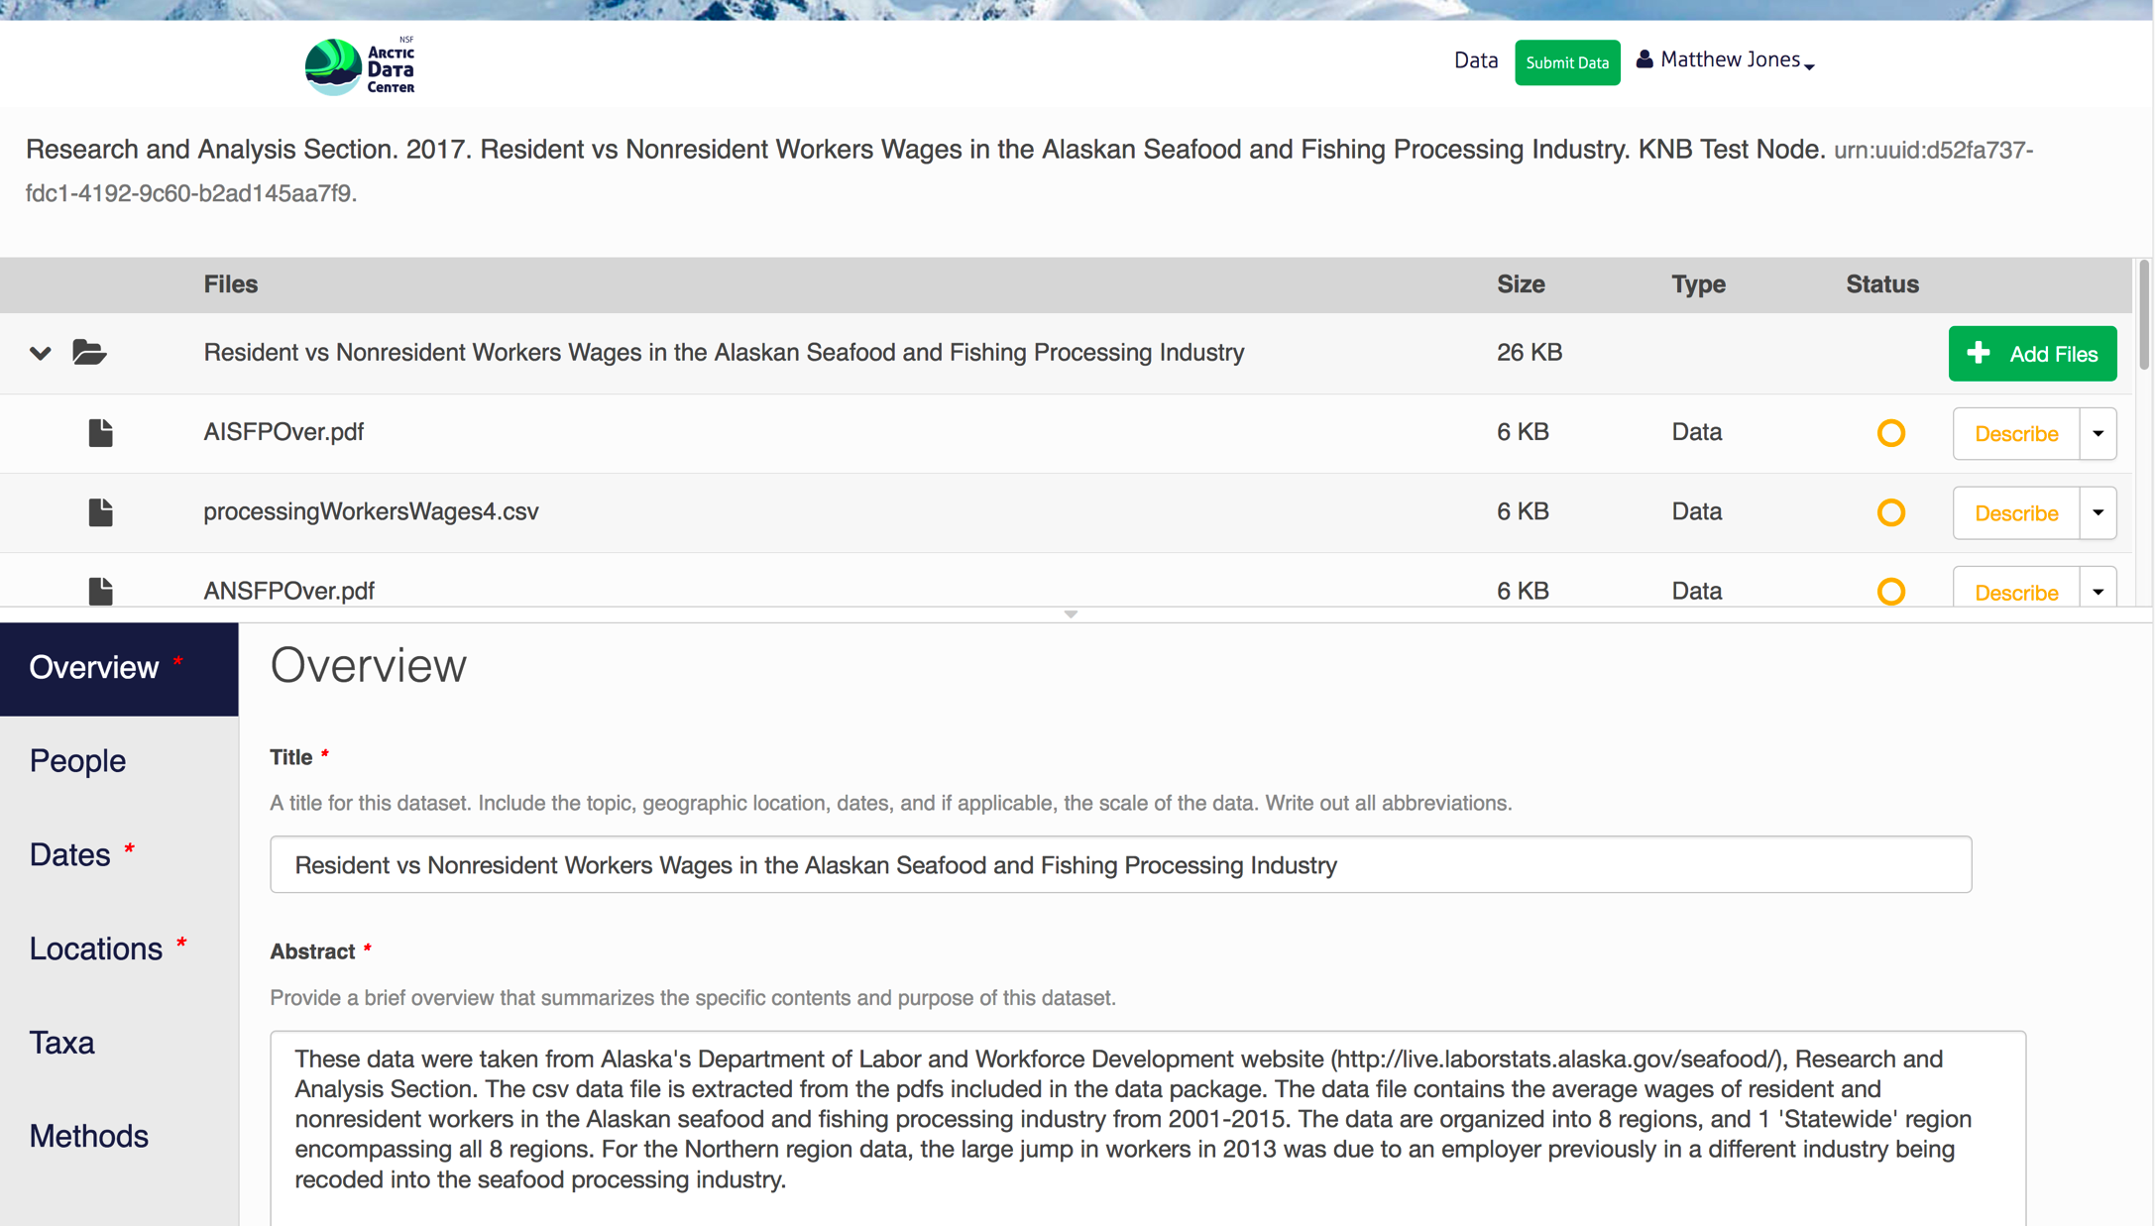
Metadata: Editors

Slide 33
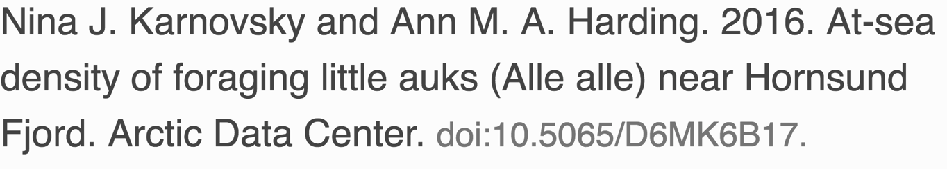
Data Identifiers
DOI == Digital Object Identifier
We assign a DOI to each published data set
Researchers should cite data they use

Slide 34
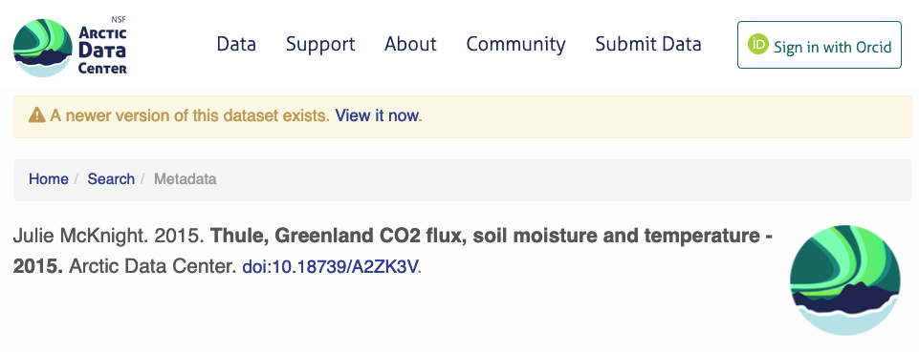
Data Versioning
Each update has a unique identifier
Cite the exact version used
Newer versions are clearly indicated

Slide 35
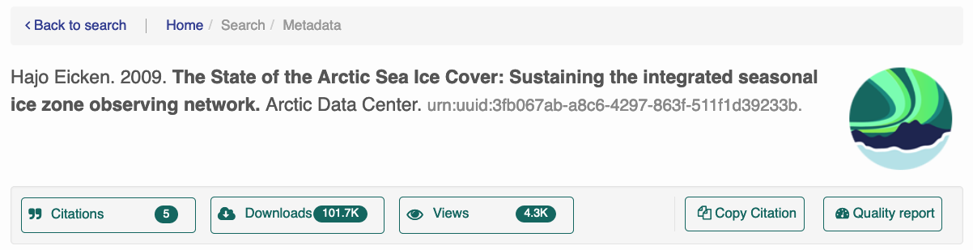
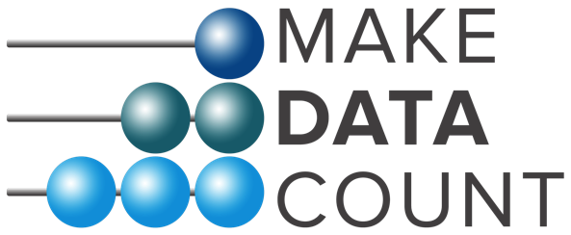
Data Usage Metrics

Slide 36
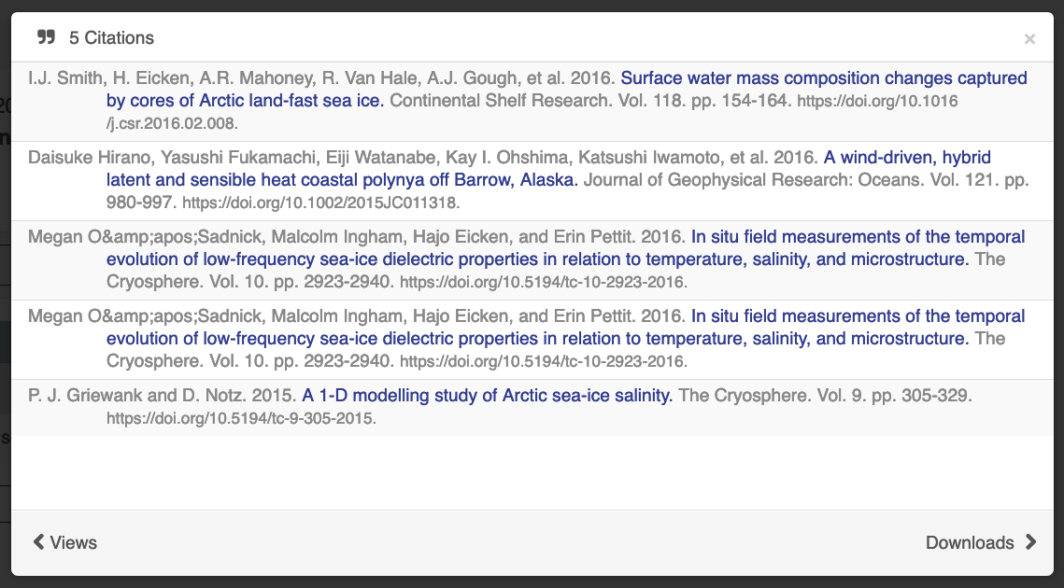
Data Usage Metrics
doi:10.18739/A2ZK3V

Slide 37
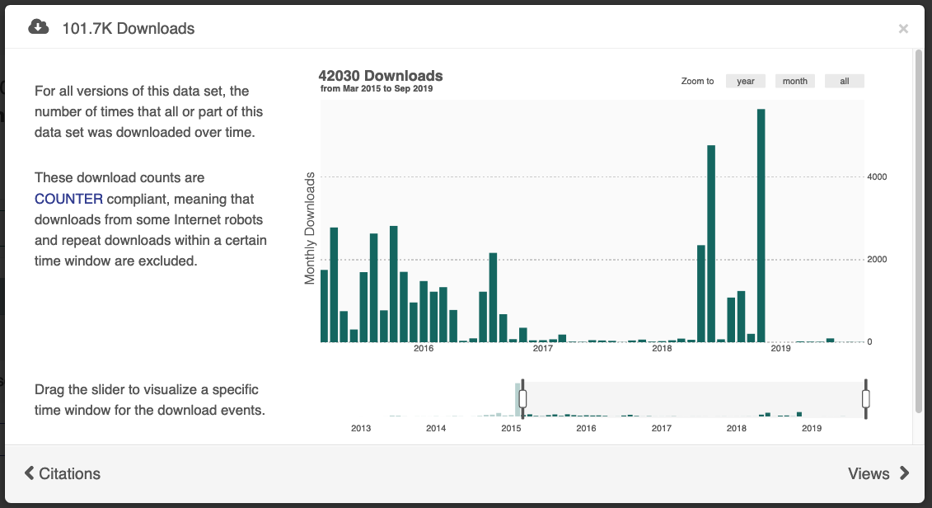
Data Usage Metrics
doi:10.18739/A2ZK3V

Slide 38
Provenance Metadata
Simplified view of complex workflows

Slide 39
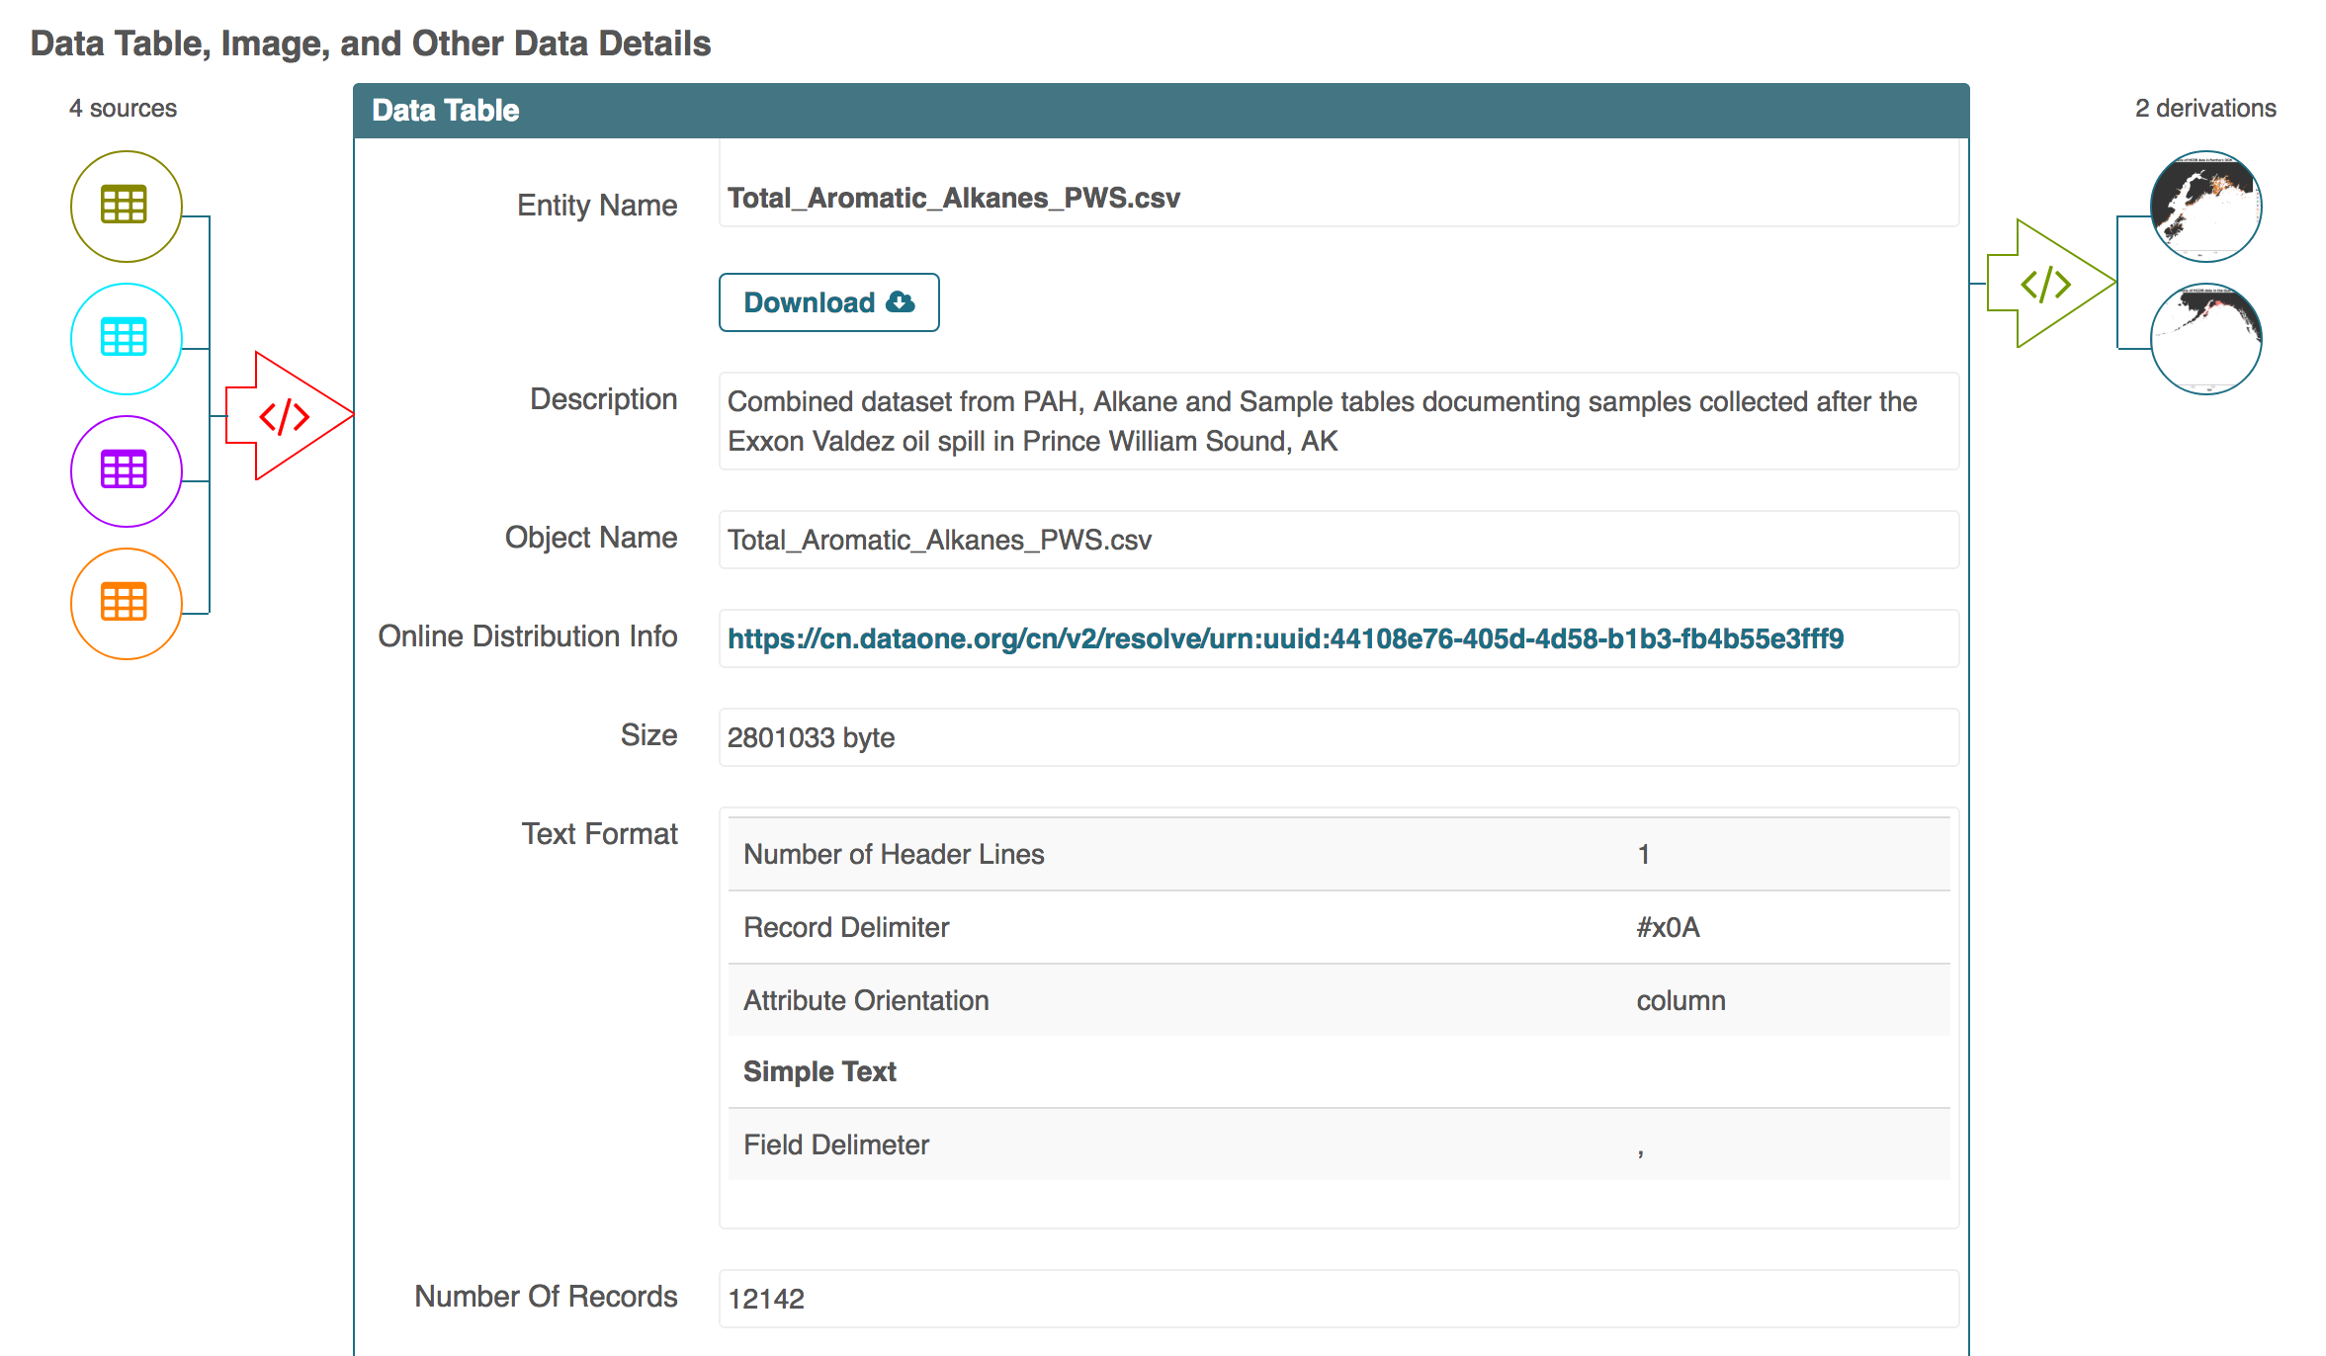

Slide 40
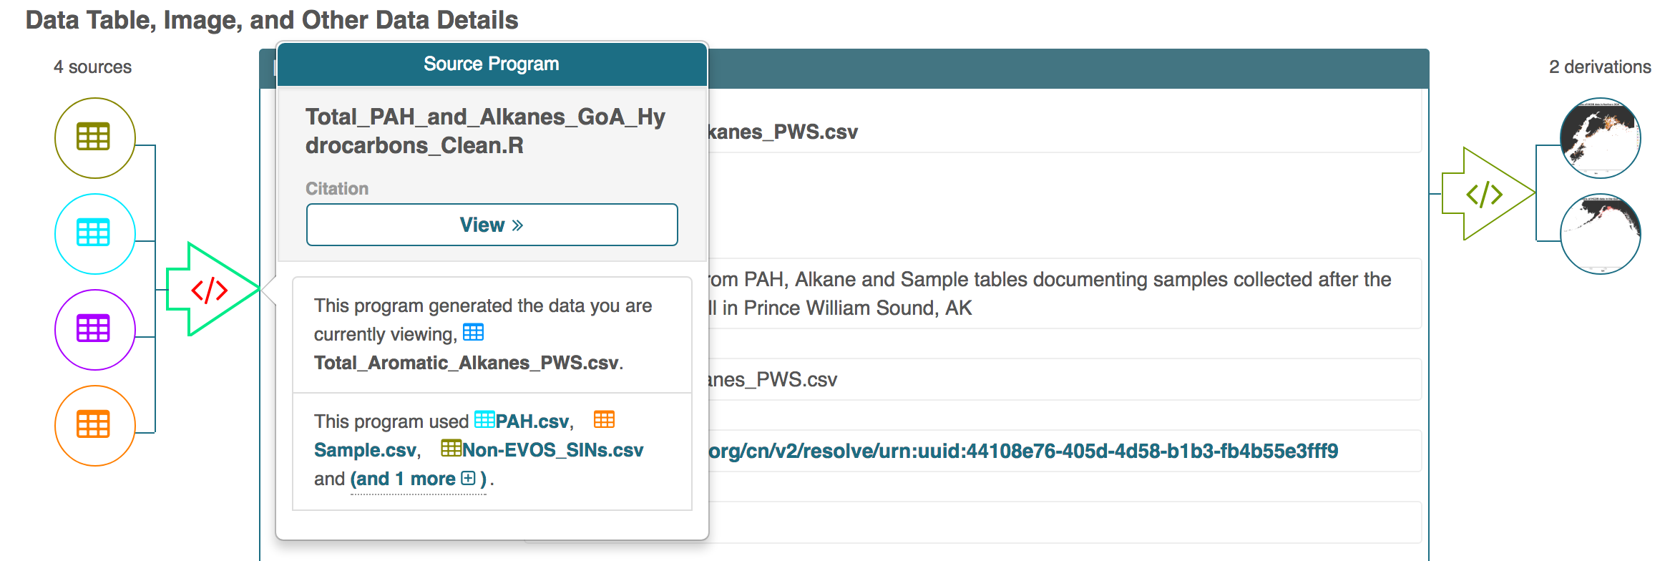

Slide 41
Data package with Provenance
Data Package 1
(doi:10.18739/A2556Q)
cito:documents
metadata
science data
science data
data granule 1
prov:
derived from
prov:used
software
figures
prov:generated

Slide 42
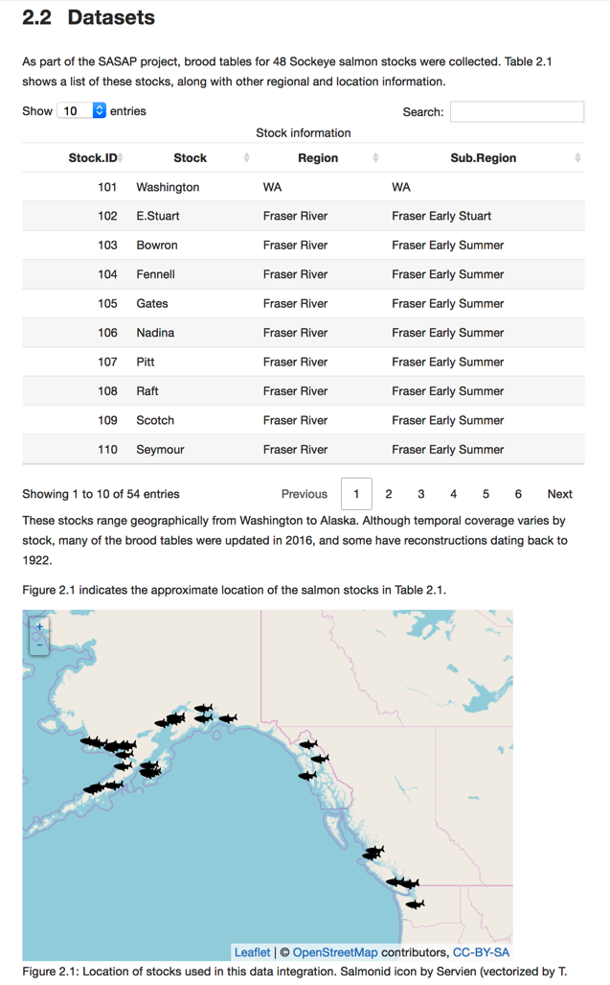
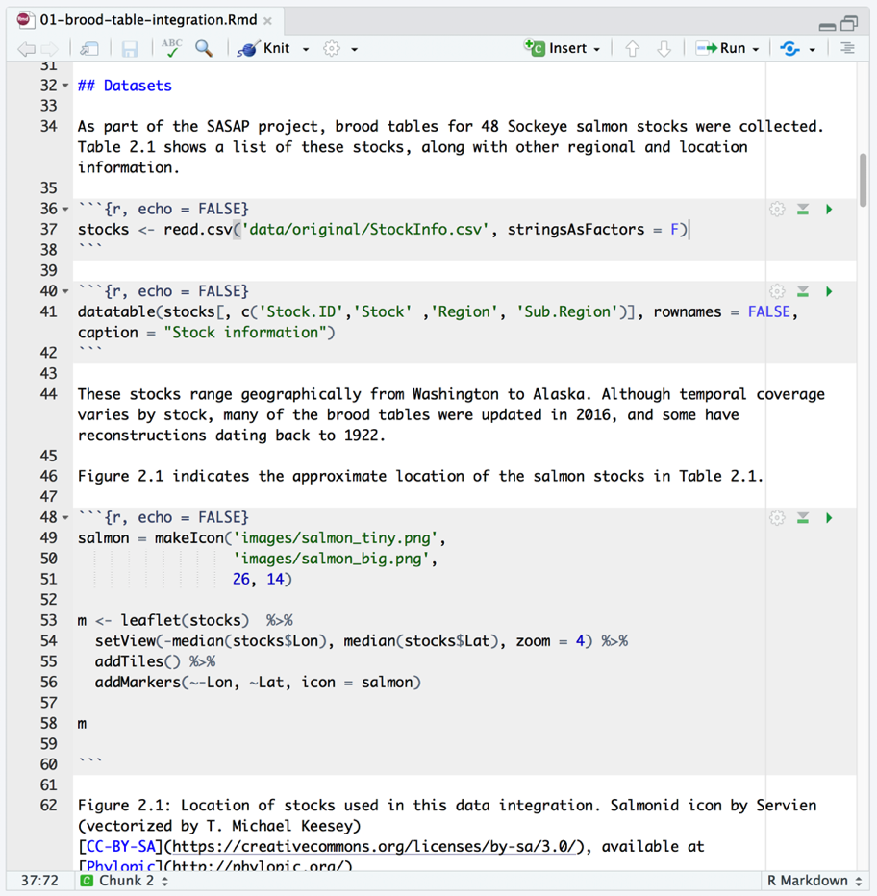
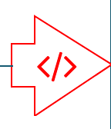
Rmarkdown as Provenance

Slide 43
Citing multi-generational workflows
Transitive Credit
Via
Provenance
Citation in paper
DOI:
Dataset C
Dataset D
Dataset A
Dataset E
Dataset B
Dataset F

Slide 44
Guidelines
https://arcticdata.io/submit/
Organizing Data
File Formats
Large Data Packages
Metadata
Data Identifiers
Provenance
Troms Fylke

Slide 45




Arctic Data Center Support Team
support@arcticdata.io
Clark
Mullen
Chong
?
?
Sun
Student Interns

Slide 46
https://arcticdata.io

